Slide 1
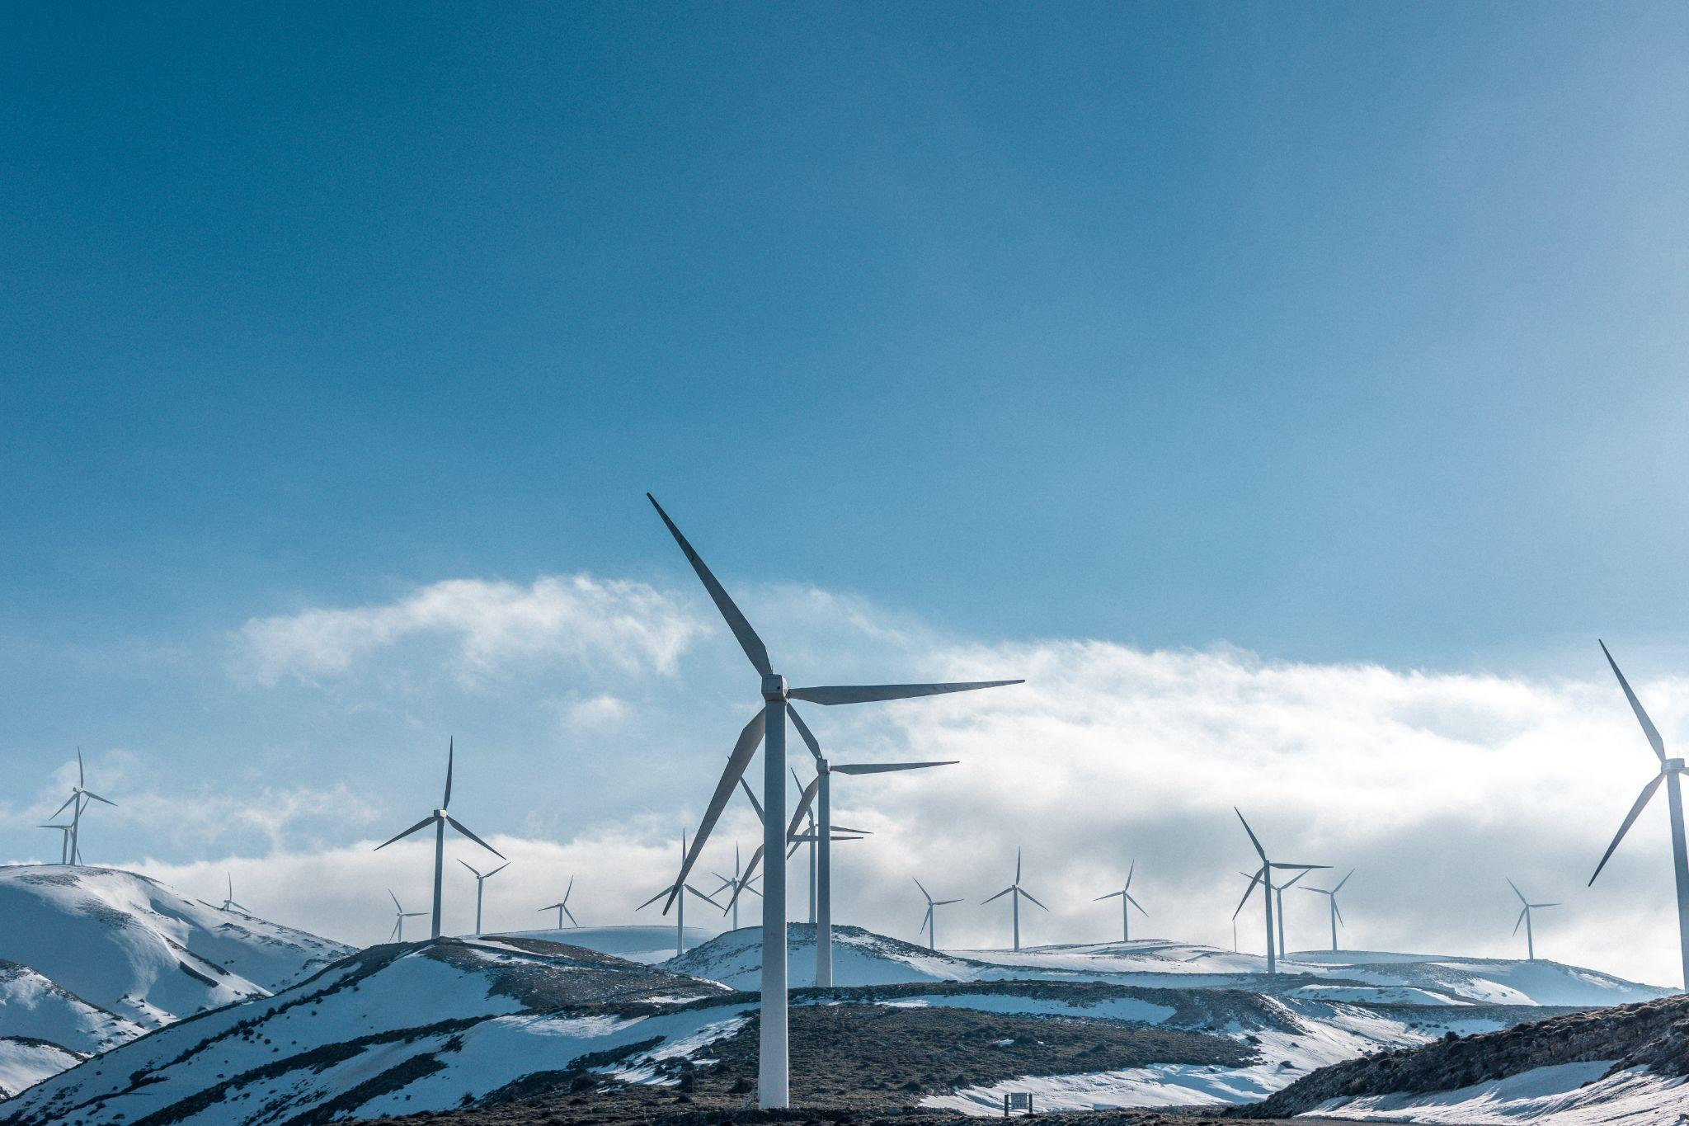
Techlauncher - Audit 1
Project: IO Energy

Slide 2


About our Client
IO Energy is an energy company located in Adelaide, South Australia.
Intension: They hope to use a time-of-use pricing to reward customers for using more clean energy to reduce carbon emissions, by providing an 80% discount on electricity that is used between 10am and 3pm.

Slide 3
The TechLauncher Team
TEAM
Name | Main Role
Xi Chen (Chloe) | Spokesman, Client Contact, Scheduling, UI Designer, Front-end Developer
Jingyi Wang (Shirley) | Deputy Spokesman, Project Manager, Data Analysis and Visualisation
Qixuan Ren (Natalie) | Backend Developer, Documentation
Yifei Tao (Katherine) | Data Analysis, Documentation
Yuexin Chen (Kevin) | Backend Developer, Database Administrator, Quality Control

Slide 4

Contents
The Problem
Project current state
The Objectives & Deliverables
Our plan
Details

Slide 5

The problem
General Background
Solar and wind energy are relatively cheap and environmentally friendly sources of power.
Last year, 60% of South Australia's electricity was generated by renewable energy.
70% during the daytime was renewable energy, Only 38% at night was renewable energy.
This Project
Our client wants to obtain more customers through improvements on product and service.
Notes:
Peter

Slide 6
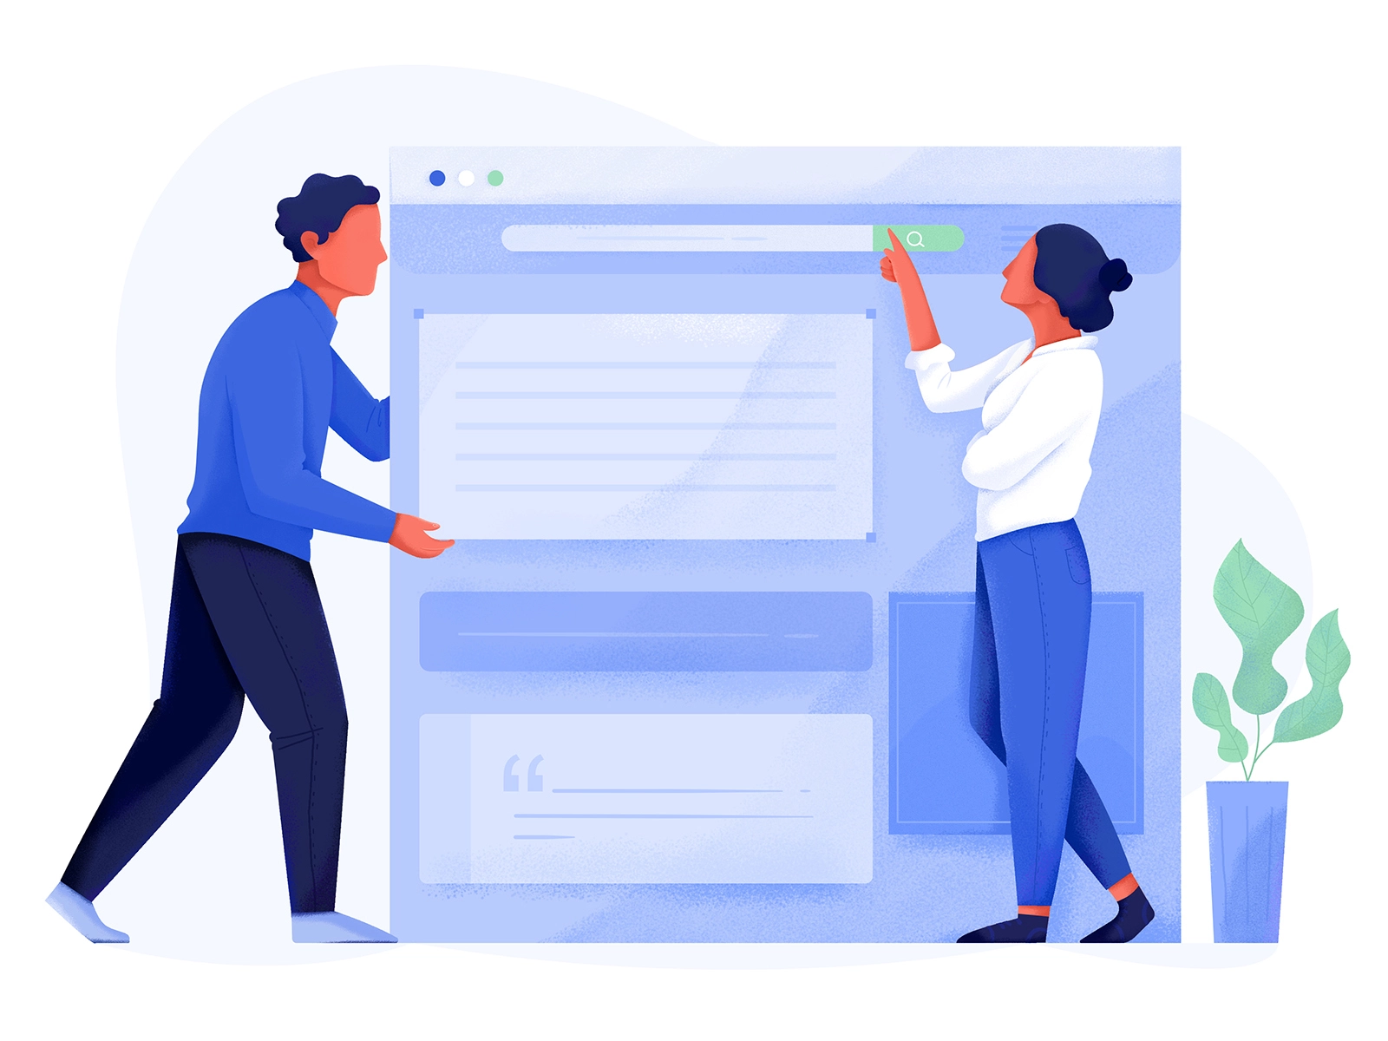
Current project state
User research & stakeholder analysis on energy consumers.
A database for existing customers’ data management and storage using PostgreSQL.
A dashboard template to show analysis results of customers’ electricity usage has been enabled using AWS for internal use.
Client is trying to apply machine learning algorithms to provide better analysis.
Notes:
Ken
Throughout the handover documents, we acknowledge that former team had developed bunch of things in last year. Including prototype, database connection, UI connection and server connection etc.
This project is an ongoing one which started the same time last year. At this stage, what we understand about the project is that the core architecture is in place, many features have been implemented, many features have been requested and some existing features needs to be improved on.
Our major goal of this semester is to work on improving and adding upon the existing implementation, keeping in mind of the eventual integration of the system.

Slide 7

The Objectives & Deliverables
THE MAIN TASKS
No. | Objectives | Deliverables
1 | Visualisation of data | An interactive UI dashboard
2 | Help customers know their bill better | Data analysis on usage pattern
3 | Help customers choose better plans | Using machine learning to make predictions of customers’ future usage and provide suggestions based on the result.
Notes:
Peter
So, the objective of this project is to streamline this process by implementing a centralised web-based management system.
This will allow all different units (and admin) to access a single source of truth.
By helping to streamline the management process, it will help to minimise any unnecessary resistance on new treatments as they make their way through the clinical trials stage.
The easier it is to manage trials, the more possible it is to have more trials running at the same time. Allowing more treatments to be made available to those who need it the most.

Slide 8

Our Plan
Notes:
Chris

Slide 9
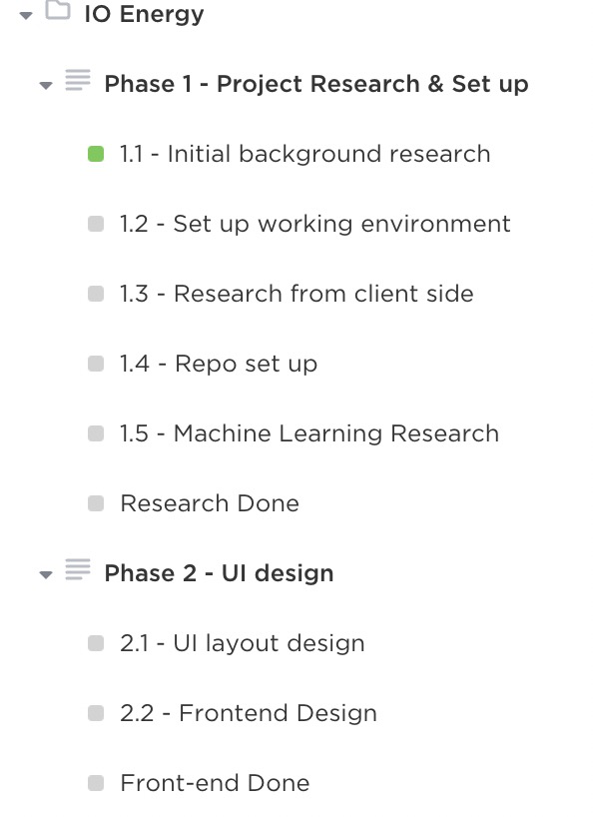
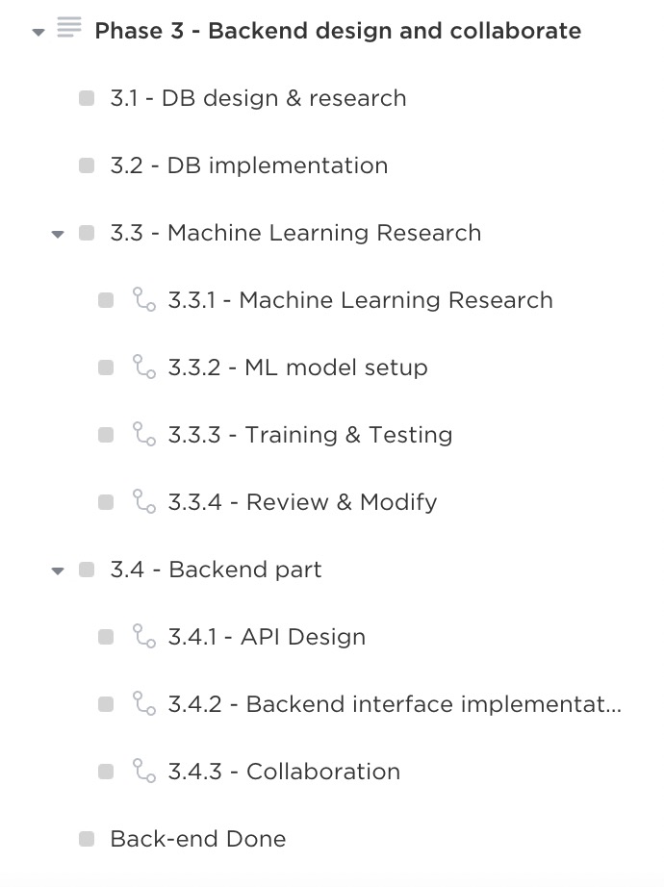
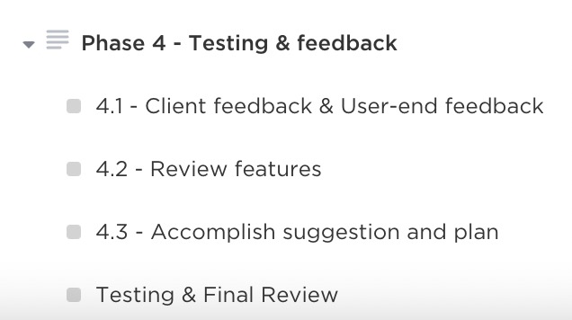
Milestones
Notes:
Yafei
Milestone of this project are listed in this chart
- At the end of week3, We will setup weekly meetings within team and with client. and review previous development and become familiar with the system as it currently stands.
- At the end of week5, A showcase of current system will be presented to users to collect user stories, and then we will set the priority and schedule for feature implementation.
- At the end of week6, We will finalize scope with the direction of the client, and begin to implement priority features identified in the showcase.
- At week 12, Compile handover document to assist new members in the following semester.

Slide 10
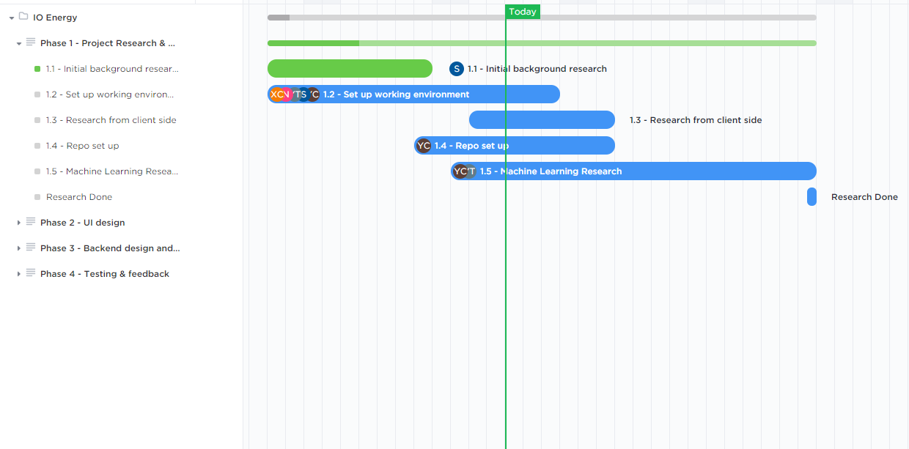
Scheduling - Gantt Chart
Notes:
Chris
(Onboarding including client interactions, meetings with additional stakeholders, Digital Solutions Division for integration, Meeting with end users to define the new requested features.
The objectives we have planned over the next couple of week are the most important ones. This week, we will attempt to get in touch with the previous primary developers to get a better understand of how the software is put together. After that, we are hoping to get in touch of with the Digital Service Division at the hospital
As you can see the gantt is very general/brief. The reason is like we mentioned, we do not have a great grasp of the system at the moment. So, while making optimistic goals might sound nice, it would be very irresponsible of us.
So over this week, we will make attempt to talk the the previous developers first to get a good overview and the inner workings of the system. We will query them about their understanding of the integration requirements. With that foundation, we aim to have a solid week of pure interpreting
what we’ve done in the first week is course work prep
we were doing some information gathering, such as reading docs and doing some research on the tools used in the system, but it was not very efficient
This week
we are hoping to meet with two lead developers from the previous team
Meet with digital solution division at the hospital
Next week
Hopefully, we got a lot of helpful information
Time to go over and take some good time to understand it
5
Showcase to end user
We will probably get more information such as requirements, features and improvements
6 & 7
These are usually when exams are, so work on project will be slowed down if not stopped completely
Further
We are hoping to get some solid development done over the teaching break before we start user testing weekly
Of course, all of this is subject to change

Slide 11

Details
Stakeholders & interaction
Tools
Constraints
Risk & Potential Costs
Resources
Notes:
Jiale
The second part that we are going to present is:
Who are our stakeholders? and How we interact with them
What tools that we use to manage the project
Constraints that may occur
How we manage risks and what will be potential costs
What resources we can learn from

Slide 12

Key Stakeholders
Customers: get better electricity plan or advice to reduce electricity expenses...
IO Energy company: gains revenue from customers, provide customers service...
Notes:
Jiale
Clinical Trials Units are our key stakeholders, the group of stakeholders on which the project manager must devote their attention to managing closely. These are the stakeholders with the largest capacity to promote the project within the business but also have the largest capacity to derail it if not carefully handled.

Slide 13
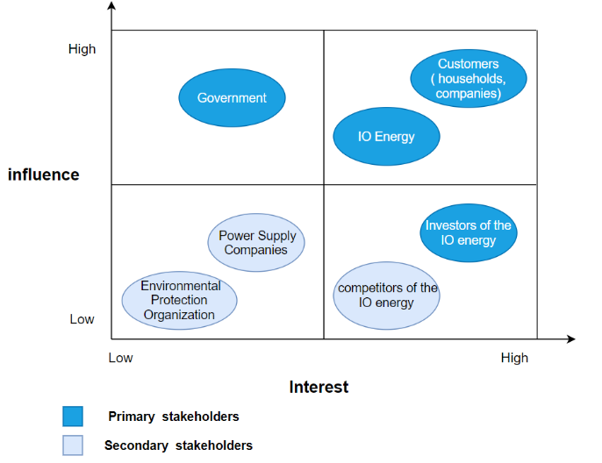
Notes:
Jiale
With the Stakeholders matrix, we can easily find the who we need to manage them closely, engage them fully, and make every effort to satisfy them. For those in the high power, low interest quadrant, put enough work to keep them satisfied, but not too much to disturb or annoy them.
Stakeholders in the low power, high interest quadrant are generally helpful to our goals, so we will keep them informed of the project’s progress.Those in the low power, low interest quadrant require minimum effort on our part. It is enough to monitor them, in case their position on the grid changes to something more significant.

Slide 14
Interaction
Regularly meet with Rob Morris (Corporate founder of IO energy)
Email
Zoom meeting
Tutorial
Notes:
Our team members have regular meetings and exchanges with rob via zoom and mail. Our team communicates internally through zoom and wechat.We will also interact with our mentors and shadow teams in tutorials to get feedback and applied reflection

Slide 15



Tools
Google docs
Project scheduling
Task assignment
Github
Repository (codes, documents)
Zoom
Team meeting

Slide 16

Constraints
IEEE standard
Data privacy
Intellectual Property Agreement
COVID-19

Slide 17


Risks and Potential Costs
Risks
Technical issue: difficulties in implementation and environmental setting
Communication issue: remote meetings lead to poor communication
Potential Costs
Time costs
Server costs
Notes:
Our team has addressed some risks that may occur through the progress of the project. For example, difficulties with the implementation and environment set up, poor communication due to remote meeting. In order to deal with the risks, we have a risk matrix and document to help us manage them. The document will always update to ensure we can avoid risks as possible.
As for the costs, we will meet time costs, server costs and hidden costs. The most important is time costs,we will spend much time on our project.
And next page will show our risk matrix in this semester.

Slide 18

Resources
Client contribute some ideas or information about IO energy at weekly meetings
Existing market research
Internet: some technology or market and related information can be found
Access to AWS, database, etc.
Notes:
Yafei
Three main resources will be used
- Firstly, Client & stakeholders' showcase feedback will be used to define user requirements and features.
The Second resource is Internet, at where API, libraries and relative tutorial could be found.
Third recourse is Previous team member
- Handover document provides detailed information about the structure of the software, what functions has implemented and what expected to implement next. Other documents like user story also give a outline of the software features.
- Documents like logs created by previous team will be a reference, and we will keep consistent style of document when writing or extending them.
- We also contact previous team members, try to solve software deployment problem.

Slide 19

Any Questions?

Slide 20
References
Colour for Graphics: #4158EA
All graphics shown in this slide was sourced from Uran Duo. License

